Slide 1
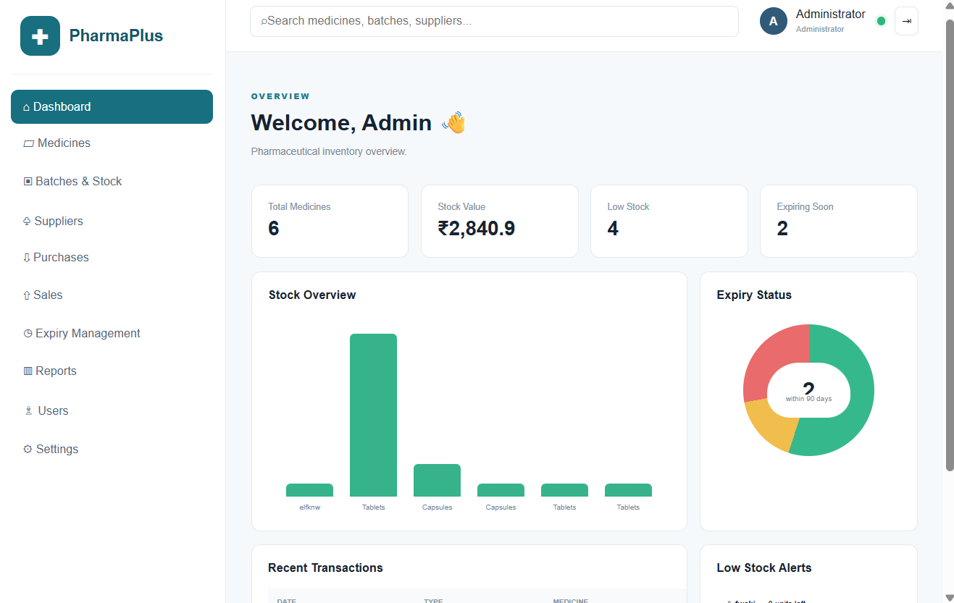
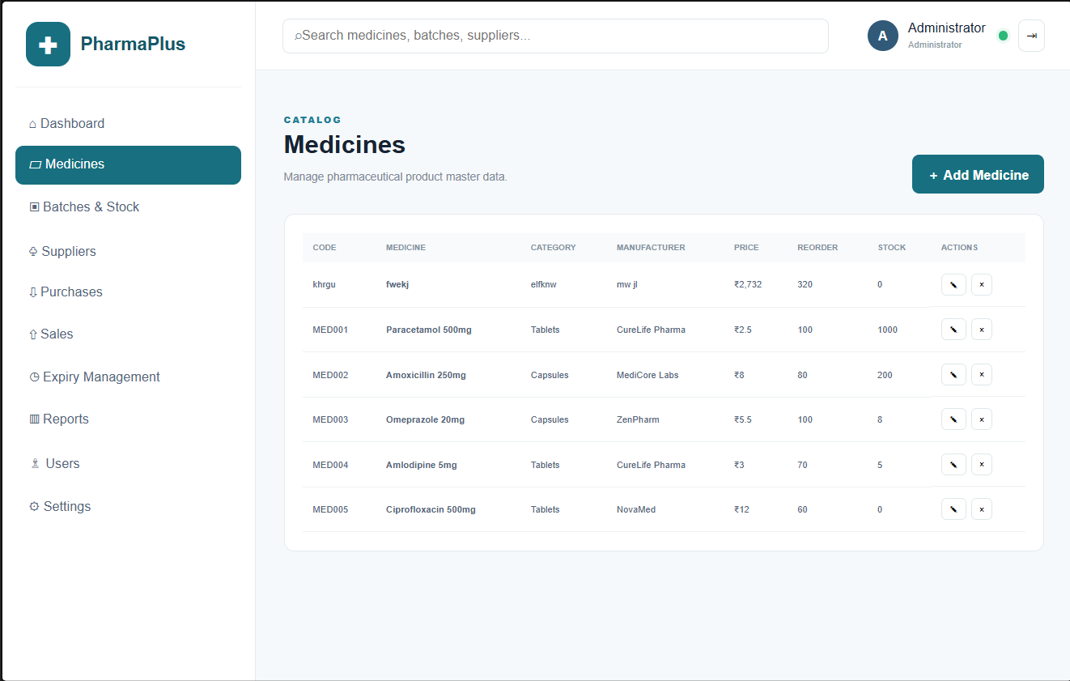
FINAL PROJECT REVIEW
Enterprise Pharmaceutical Stock and Inventory Management System
A centralized backend solution for medicines, suppliers, batches, purchases, sales and stock monitoring
Node.js · Express.js · MongoDB · REST API
K. Girish • 2520030231
P. Venkat • 2520030450
FINAL REVIEW • 2026

Slide 2
01 • CONTEXT
Problem & Motivation
Manual inventory risk
Traceability challenge
Operational visibility
Fragmented records can make quantities, transactions and expiry information difficult to maintain consistently.
Medicine batches, manufacturing dates and expiry dates need to remain connected to inventory records.
Staff need a centralized view of medicines, suppliers, purchases, sales and current stock.
Project need
Centralize pharmaceutical inventory information in one controlled backend.
Expose consistent RESTful APIs instead of relying on disconnected manual records.
Support stock and expiry monitoring through structured data and business logic.
2

Slide 3
02 • GOALS
Project Objectives
01
Centralize
Maintain medicines, suppliers, batches and transaction data in one system.
02
Automate
Reduce repetitive inventory handling through backend APIs and structured operations.
03
Track
Maintain batch, manufacturing and expiry information for traceability.
04
Monitor
Identify stock conditions such as low quantity and near-expiry batches.
05
Validate
Use API testing and database inspection to verify system behavior.
3

Slide 4
03 • SOLUTION
Proposed System
Client
REST API
Logic
Database
Authorized web / API client
→
Express.js endpoints
→
Validation + inventory rules
→
MongoDB collections
Controlled request flow
Client → API → validation/business logic → database → structured response
No direct client-to-database access
4

Slide 5
04 • TECHNOLOGY
Technology Stack
Node.js
Express.js
MongoDB
JavaScript runtime for the backend
RESTful API framework and middleware
Document-oriented inventory database
MongoDB Compass
Postman
VS Code + npm
Database inspection and management
API request and response testing
Development, debugging and dependencies
5

Slide 6
05 • ARCHITECTURE
System Architecture
CLIENT
Authorized web / API client
↓
API LAYER
Express.js REST endpoints
↓
BUSINESS LOGIC
Validation • authorization • inventory processing
↓
DATA LAYER
MongoDB collections and records
The client communicates with MongoDB only through the controlled REST API boundary.
6

Slide 7
06 • MODULES
Core Functional Modules
1
Medicine Management
2
Supplier Management
Create, retrieve, update and delete medicine records.
Maintain supplier information and source details.
3
Batch Management
4
Purchase Management
Track batch numbers, manufacturing dates and expiry dates.
Record incoming stock transactions.
5
Sales Management
6
Stock & Expiry Monitoring
Record outgoing stock transactions.
Track quantities and identify low-stock / near-expiry conditions.
7
Access Control
Restrict sensitive operations to authorized staff.
7

Slide 8
07 • DATA
Logical Database Design
MEDICINE
SUPPLIER
BATCH
PURCHASE
Medicine ID • name • category • quantity/status
Supplier ID • name • contact details
Batch ID • medicine reference • MFG • EXP
Purchase ID • supplier • date • transaction details
SALE
STOCK
USER / STAFF
Sale ID • date • transaction details
Medicine/batch reference • available quantity
User ID • role • credentials/status
Traceability focus: Medicine → Batch → Purchase/Sale → Stock
8

Slide 9
08 • WORKFLOW
Request-to-Response Data Flow
1
2
3
4
5
REQUEST
MIDDLEWARE
BUSINESS LOGIC
DATABASE
RESPONSE
Client sends HTTP request
Parse • validate • authorize
Apply inventory rules
Read / write MongoDB
Return structured status + data
Example: a purchase can create a purchase record and increase the related stock quantity.
9

Slide 10
09 • API
REST API & Implementation
GET /medicines
router.get("/medicines", async (req, res) => {
const medicines = await Medicine.find();
res.status(200).json(medicines);
});
router.post("/medicines", async (req, res) => {
const medicine = await Medicine.create(req.body);
res.status(201).json(medicine);
});
Retrieve medicine records.
POST /medicines
Create a new medicine record.
PUT / PATCH
Modify an existing resource.
The API separates clients from MongoDB and provides a consistent HTTP contract.
10

Slide 11
10 • FEATURES
Key Features
Centralized inventory
Batch traceability
Single backend for medicines, suppliers and inventory transactions.
Batch number, manufacturing date and expiry date tracking.
Stock monitoring
Expiry monitoring
Current quantity visibility and low-stock identification.
Near-expiry and expired batch identification.
RESTful integration
Access control
Standard HTTP operations with structured responses.
Authentication and authorization concepts for protected operations.
Independent testing
Extensible design
Postman validates APIs; MongoDB Compass verifies persisted data.
Reporting, notifications and integrations can be added around existing data.
11

Slide 12
11 • TESTING
Testing & Validation
Test type | Tool / scope | What it checks
API Testing | Postman | Verify methods, request data, response body and status codes.
Database Verification | MongoDB Compass | Confirm records are created or updated as expected.
Integration Testing | API + Database | Check that transactions produce the intended inventory effect.
Negative Testing | Invalid / missing inputs | Validate error handling and controlled responses.
Testing principle: Validate both successful operations and controlled failure conditions.
12

Slide 13
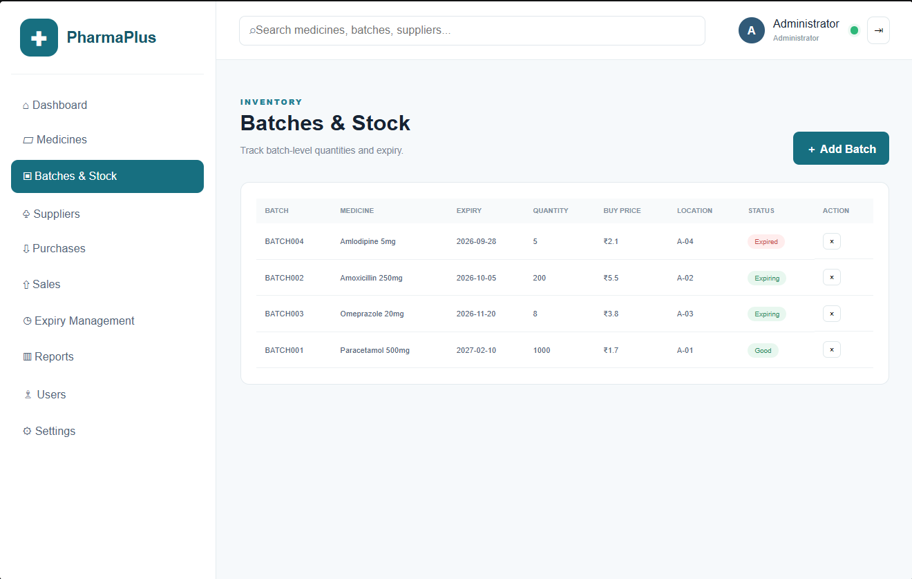
12 • DEMONSTRATION
Application / Project Evidence
Dashboard / API view
Medicine management
Batches & stock
Use this slide during review to demonstrate the implemented workflow and API/database evidence.
13

Slide 14
13 • ENGINEERING
Challenges & Solutions
Challenge | Issue | Solution
Stock consistency | Purchase increases stock; sale decreases stock. | Controlled business logic + integration testing
Expiry tracking | Dates must remain consistent and comparable. | Batch-level date storage + backend checks
API validation | Invalid or incomplete requests can create bad records. | Validation before database operations
Configuration | Connection strings, ports and environment values can cause failures. | Environment-based configuration + documented setup
14

Slide 15
14 • ROADMAP
Future Enhancements
1
2
3
Automation
Analytics
Identification
Low-stock and near-expiry alerts; automated backup and recovery workflows.
Inventory, purchase, sales, expiry and supplier-performance reports.
Barcode / QR-code based medicine and batch identification.
4
5
6
Integration
Performance
Security
Supplier, accounting or billing system integration.
Database indexing, query optimization and carefully designed caching.
Stronger audit logging, rate limiting, secret management and access reviews.
15

Slide 16
FINAL TAKEAWAY
A structured backend foundation for pharmaceutical inventory management
Q&A
Thank You
The project connects REST APIs, business logic and MongoDB to centralize inventory data, support traceability, and enable stock and expiry monitoring.
K. Girish • P. Venkat
Enterprise Pharmaceutical Stock and Inventory Management System

